Slide 1
Garaj Mail
your complete email solution

Slide 2
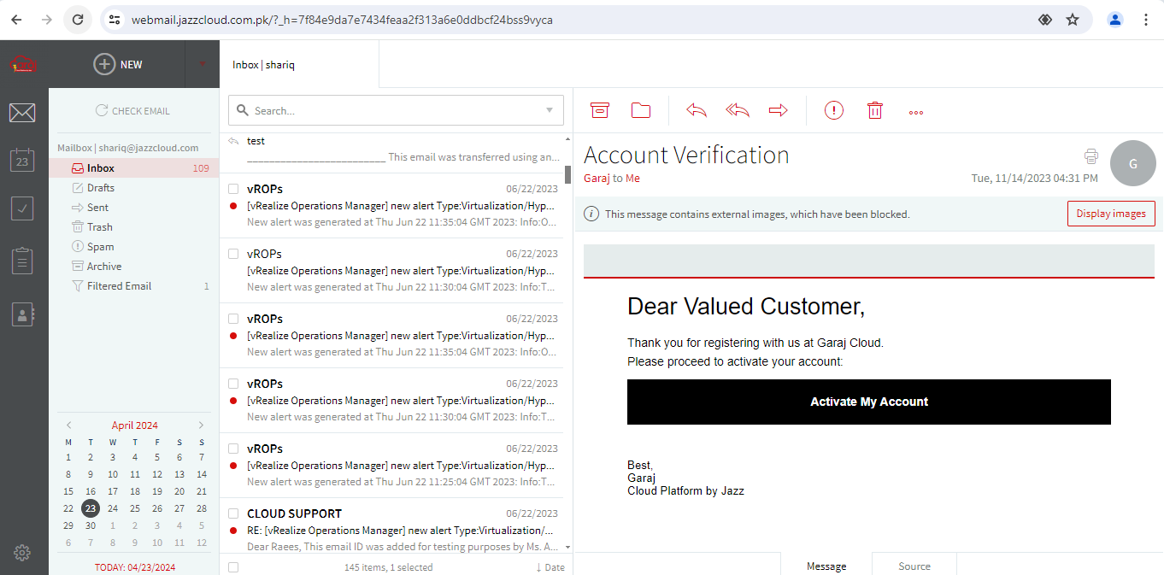
Garaj’s Journey To Seamless Email Management
comprehensive email solution built on Axigen platform
customizable email management
user friendly interface
integration with other business tools
scalable for businesses of all sizes

Slide 3
Product Features
Robust Email Management
Intuitive Webmail Interface
Comprehensive and resilient platform designed to handle all aspects of email management efficiently
easy-to-navigate platform that allows users to access, organize and interact with emails seamlessly
Cross Platform Compatibility
Efficient Search & Filters
users can access email accounts across a variety of devices & operating systems providing flexibility and convenience
empowers users to quickly locate and manage their emails with precision to stay organized and save time
Monitoring & Reporting
Secure Communication
provides administrators with comprehensive visibility into user activities, message delivery, storage usage, and compliance status
ensures that all email communications are protected against unauthorized access, interception and data breaches
User Management & Control
Mobile Sync & Active Sync
provides administrators with robust tools to manage user accounts, enforce access controls, and ensures the security and integrity of email system
enables users to synchronize emails, contacts, calendars, tasks, and other data between their Garaj email account and mobile devices

Slide 4
Why Garaj Mail?
A fully-featured and customizable mail server platform designed to give your business the tools, power, and support needed to scale
local server in Pakistan
Compliance with governing bodies
24/7 local support
certified Garaj experts
Provides end users with faster access, improved security, data sovereignty and reliability
Adherence to regulatory standards, providing users with confidence in data security and legal compliance
Users have peace of mind and immediate assistance (via call & email) for their email needs
Users have access to knowledgeable professionals for optimal email management
@
invoice in PKR
affordable price
customized email domain
Facilitates invoicing in PKR mitigating uncertainties amidst current economic volatility in Pakistan
Ensures cost-effectiveness without sacrificing quality or performance
Provides users with a professional and tailored email identity enhancing credibility and trust

Slide 5
Packages
BASIC
STANDARD
PREMIUM
Email
Calendar
Mailing Lists/Groups
Contacts
Mailbox
Antispam
Anti-virus
Tasks
Notes
Folder sharing
Active sync
Storage
5 GB
5 GB
5 GB
Rs. 799/-
Rs. 999/-
Rs. 1,199/-
*prices are per user per month
*prices are exclusive of taxes

Slide 6
Technical Support
Billing & Invoicing
To Learn More
cloud.support@jazz.com.pk
garaj-cloud@jazz.com.pk
bizcloudbilling@jazz.com.pk
0304 1110365 (24/7 helpline)
garajcloud.com

